Slide 1


Team 6: Telescope Autofocuser
Bi-Weekly Update 5 Albin Myscich
Alonna Too-Chiobi
Camille Watson
Joseph Basdeo
Sponsor: Dr. Kevin Nowka
TA: Max Lesser
Notes:
Michelle

Slide 2
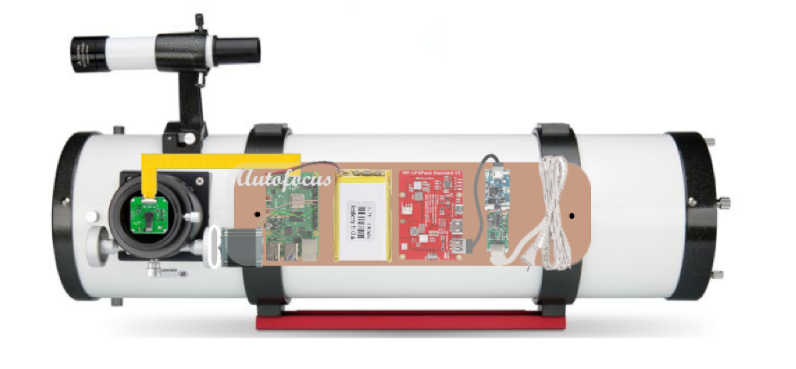
Project Summary
Telescope focusing & image processing automation
Product Will:
Stream current images to dev board using an imager
Autofocus using a stepper motor interface
Display focused image post processing through a GUI
Notes:
Kyle

Slide 3
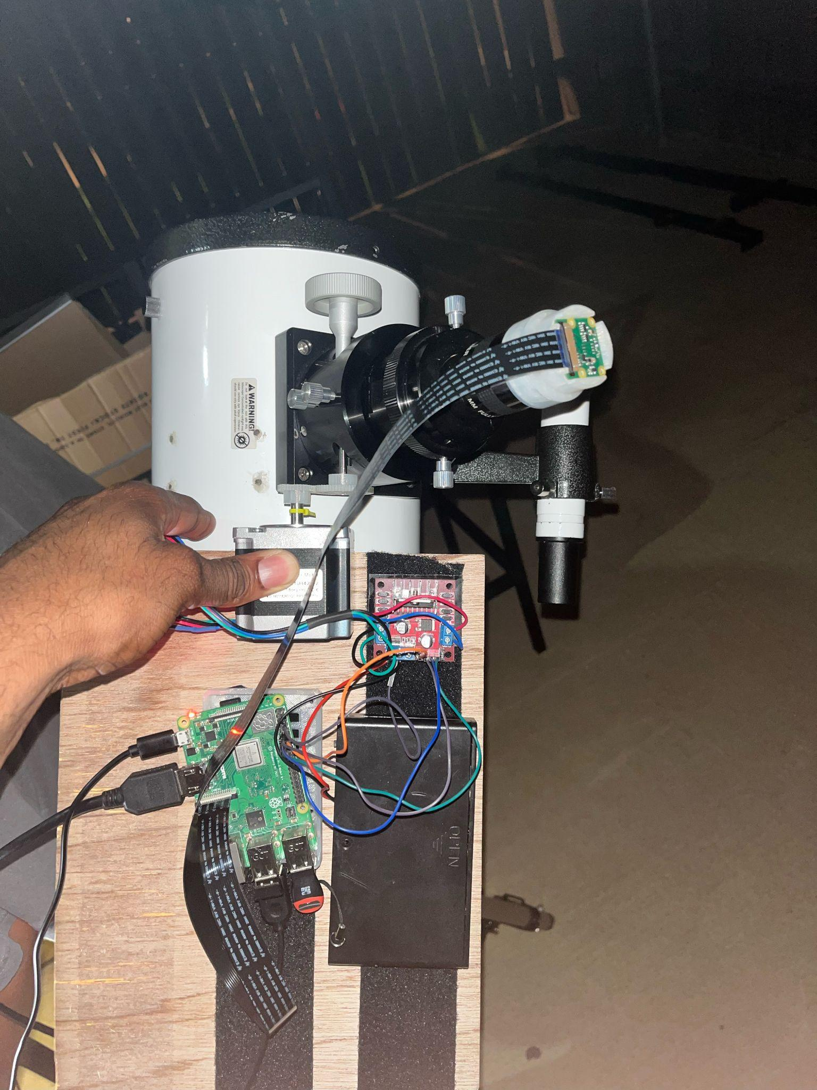
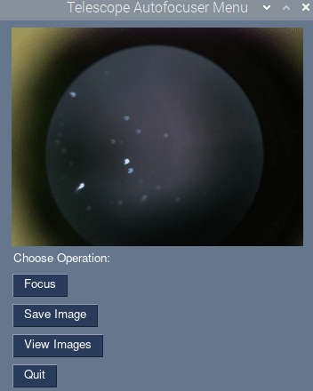
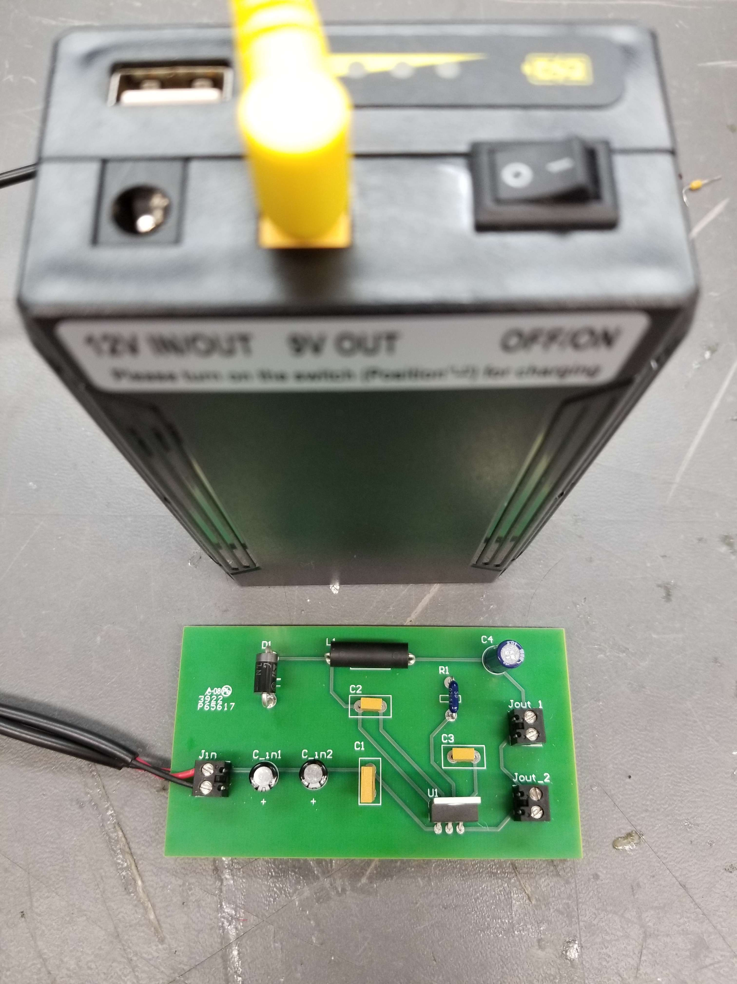
Integrated System Diagram
Image Display
Autofocus & Image Process Input
User Interface
Imager and motor integration with telescope and mount
Power Supply
Notes:
Eric

Slide 4
Project Timeline
Subsystem Designs and Testing (completed 4/21) | Integration of Motors, Autofocusing Program, and Imager Subsystems (to completed by 10/14) | Integration of Image Processor and GUI (to completed by 10/14) | Integration of Power Supply with all Dependent Subsystems (to completed by 10/14) | Final Integration (to complete by 10/28) | System Test (to complete by 11/11) | Validation (to complete by 11/28) | Demo and Report (to complete by 12/2)

Slide 5
Motor Assembly
Alonna Too-Chiobi
Accomplishments since last update 11.5 hrs of effort | Ongoing progress/problems and plans until the next presentation
Rectified issues with motor control program and re-validated performance | Design, print, and test gear box Complete integration of Autofocusing Program and Motor Assembly subsystems Complete ongoing validation of Motor function while powered by Power Supply subsystem

Slide 6
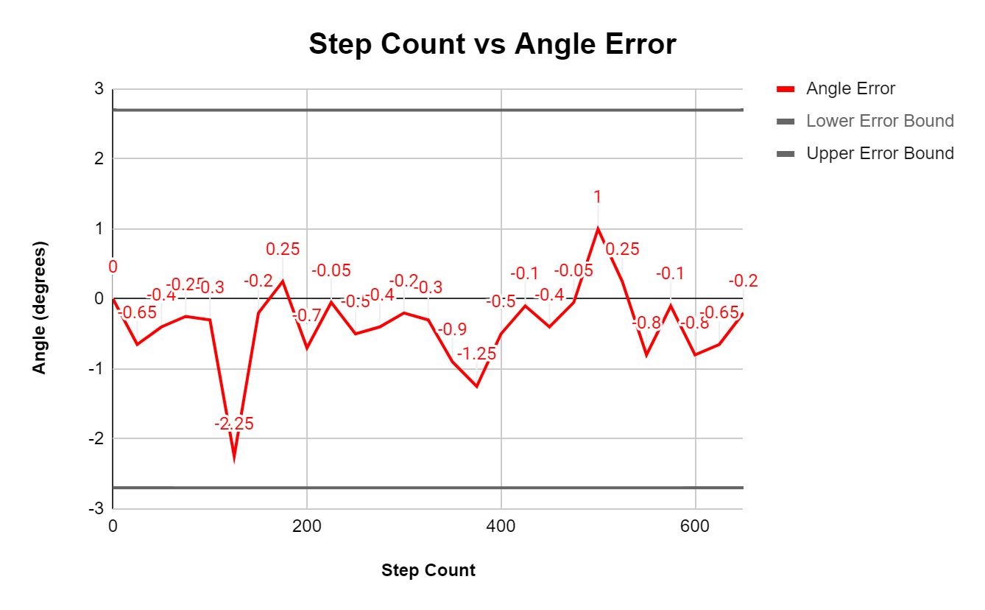
Motor Assembly
Alonna Too-Chiobi

Slide 7
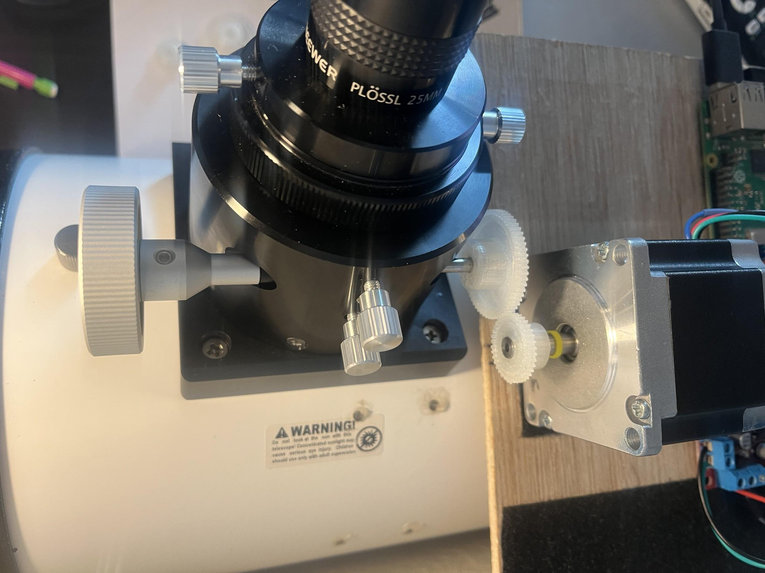
Motor Assembly
Alonna Too-Chiobi
Figure: Gear assembly
Gear Ratio = Teeth of driven gear/Teeth of driver gear = 1.667
400 steps = 360 degrees for motor shaft
666.8 steps = 360 degrees for focuser shaft

Slide 8
Imager & Mounting Assembly
Joseph Basdeo
Accomplishments since last update 9 hrs of effort | Ongoing progress/problems and plans until the next presentation
Obtained higher magnification lenses from sponsor Stabilized counterweight assembly Designed and printed imager mounts for new eyepieces Finalized GUI menu application | Ongoing system validation with focuser software Developing error testing for high light pollution scenarios Optimizing shutter speed for increased focusing performance

Slide 9
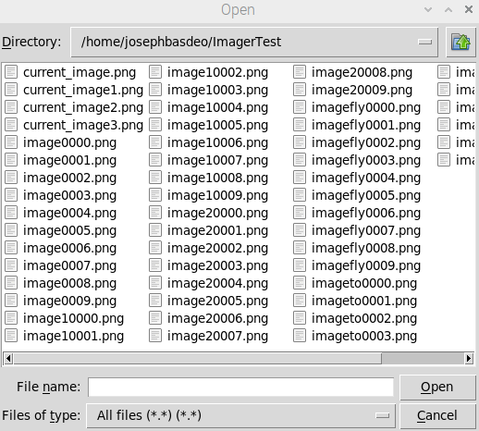
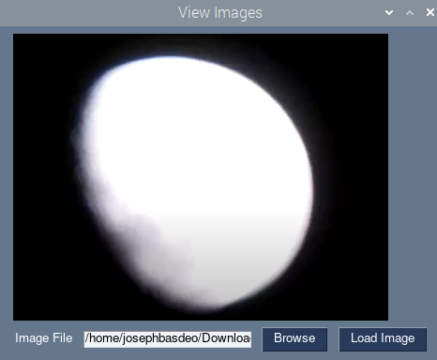
Imager & Mounting Assembly
Joseph Basdeo
Menu
Folder of capture imagers
Image Display

Slide 10
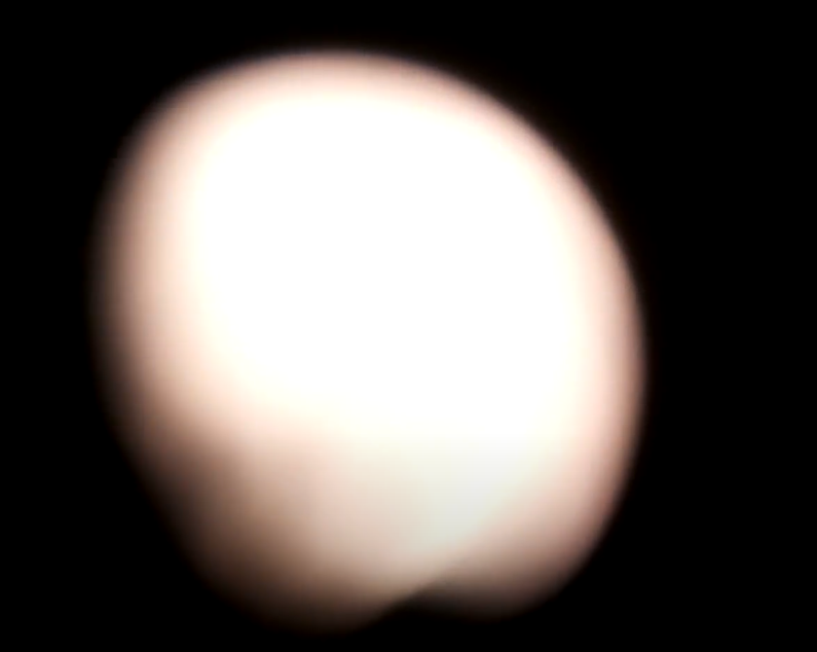
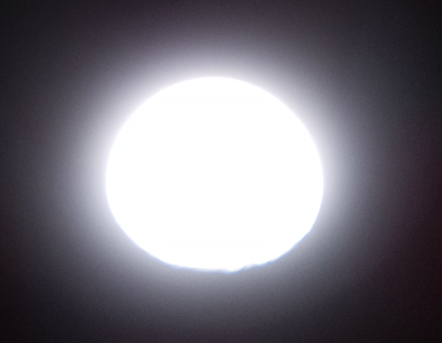
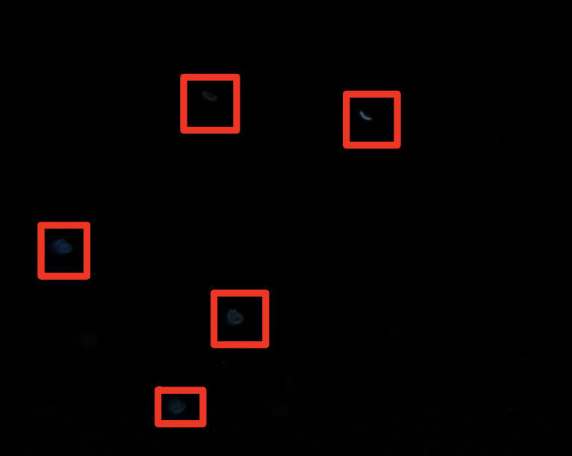
Imager & Mounting Assembly
Image | Error
Moon (Unfocused) | Ambient light pollution (reddish hue) Solution: relocating to dark areas away from city lighting
Moon (Focused) | High vs. Low light admittance Solution: Set ISO values and shutter speed specific to desired space objects
Stars (Focused) | Low light admittance example

Slide 11
Power Supply
Camille Watson
Accomplishments since last update 12 hrs of effort | Ongoing progress/problems and plans until the next presentation
Finished soldering PCB Validated PCB using line regulation testing Began integration between power supply and Raspberry Pi Performed initial validation with Raspberry Pi using a stress test | Finish validation for PCB using load regulation Begin validation between power supply and motor subsystem Continue validation between power supply and Raspberry Pi

Slide 12
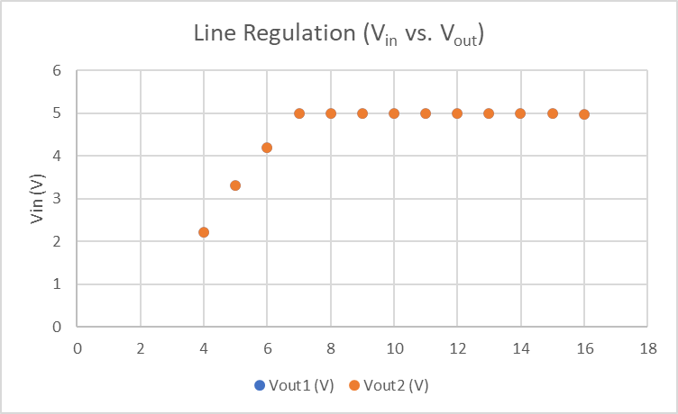
Power Supply
Camille Watson
Power Supply
Camille Watson
V_{supply} (V) | V_{in} (V) | V_{out1} (V) | V_{out2} (V)
4 | 4.003 | 2.21 | 2.21
5 | 5.002 | 3.32 | 3.319
6 | 6.002 | 4.199 | 4.199
7 | 7.003 | 4.987 | 4.987
8 | 8.002 | 4.988 | 4.988
9 | 9.003 | 4.988 | 4.987
10 | 10.002 | 4.987 | 4.987
11 | 11.002 | 4.987 | 4.987
12 | 11.995 | 4.987 | 4.987
13 | 12.995 | 4.987 | 4.987
14 | 13.994 | 4.987 | 4.987
15 | 14.994 | 4.987 | 4.987
16 | 15.993 | 4.986 | 4.986
Line Regulation Graph
Buck Converter PCB Setup
Line Regulation Table

Slide 13
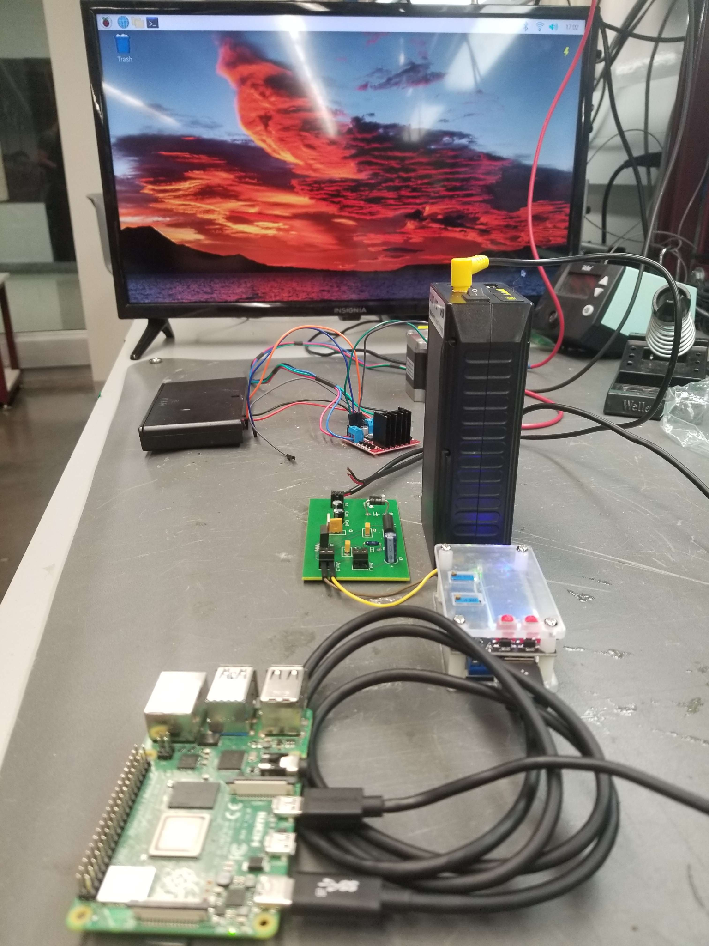
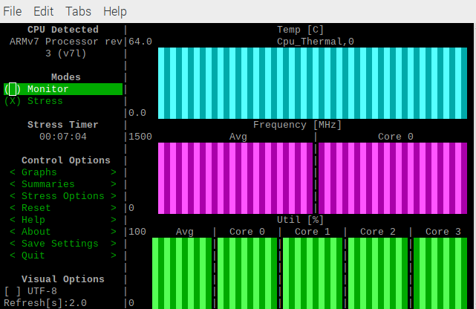
Power Supply
Camille Watson
Power Supply
Camille Watson
Stress Test:
Method: Delivered a load onto the CPU in order to draw a larger voltage drop with a higher amperage and test the reliability of the power supply
Results: After approximately 7-8 minutes of running the stress test, the power supply only experienced a voltage drop of ~100mV
Integration between Power Supply and Raspberry Pi
Stress Test Readings

Slide 14
Image Pre/Post-Processing Program
Albin Myscich
Accomplishments since last update 19.6 hrs of effort | Ongoing progress/problems and plans until the next presentation
FoFi-Raspberry Pi integration testing Hardware support limits Star Outlier Detection Median and Interquartile Deviation Method (IQD) | FoFi-Raspberry Pi software translation Lightweight derivative Continued FoFi-Raspberry Pi integration testing

Slide 15
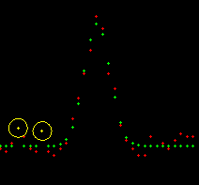
Image Pre/Post-Processing Program
Albin Myscich
Collected data contains noise
Median and Interquartile Deviation Method (IQD)
Half Width Flux Diameter Metric
4th quantile of the residuals
IQR = Q3 - Q1
UB: (Q3 + 1.5 * IQR)
Acceptance factor of 1.5
Outlier if residual is greater
than acceptance factor
Curve matching without the
detected outliers
Default boundary is 15% of the data points
Yellow - outliers
Green - Ideal samples
Red - Sampled values

Slide 16
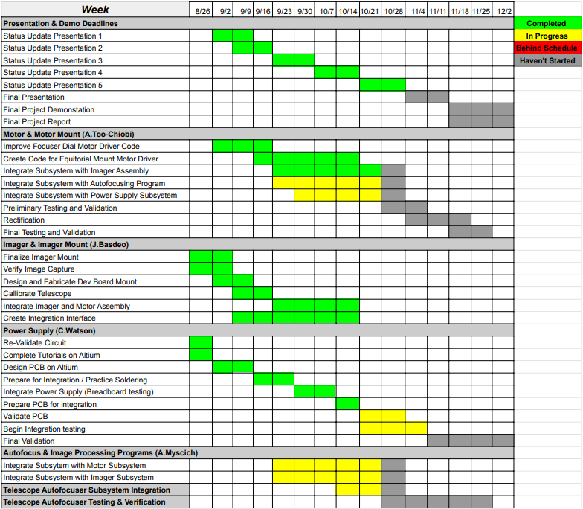
Execution & Validation Plan
Notes:
Michelle

Slide 17
Thank You
Questions?

